Slide 1
The Mesosphere and it’s Energy Budget
By: Nick Buccongello and Kasia Wisniewski

Slide 2
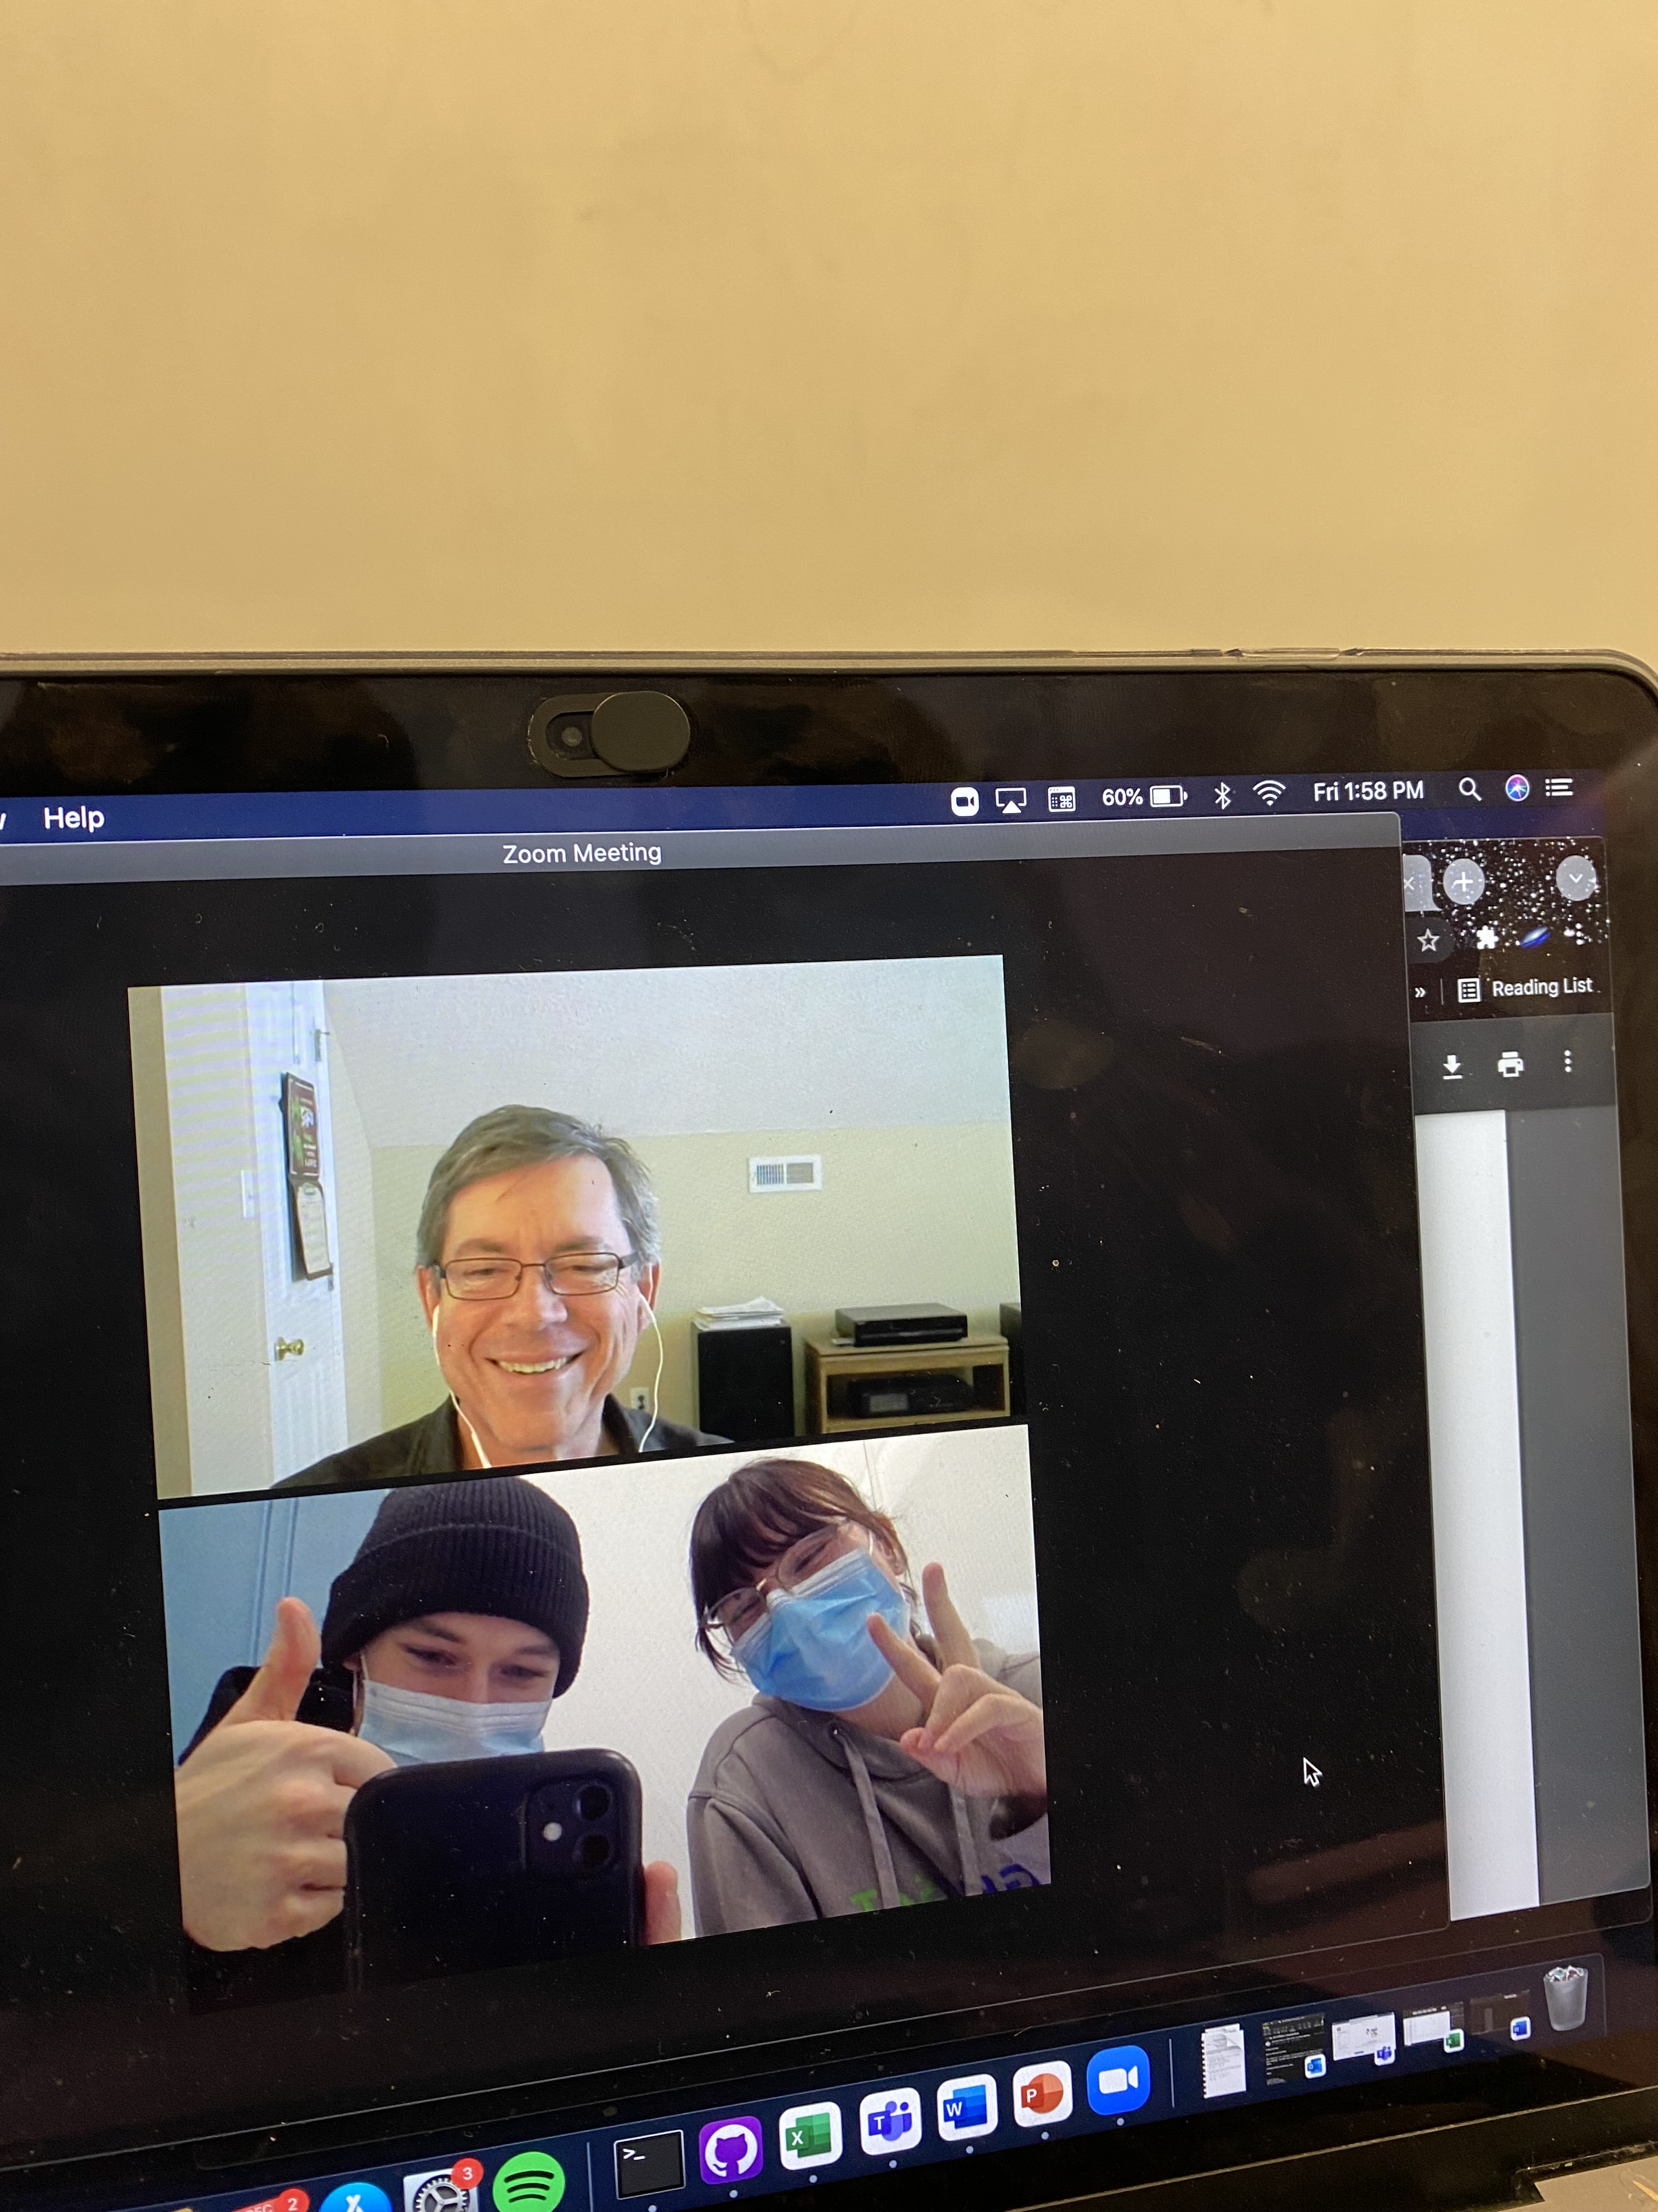
Acknowledgments
Thank you to Bob Sica, graduate course teaching expert
Thank you to Martin Mlynczak, Senior Research Scientist (NASA), SABER Principal Investigator, mesosphere energy budget expert
Thank you to our supervisor Professor Peter Brown, meteor expert

Slide 3
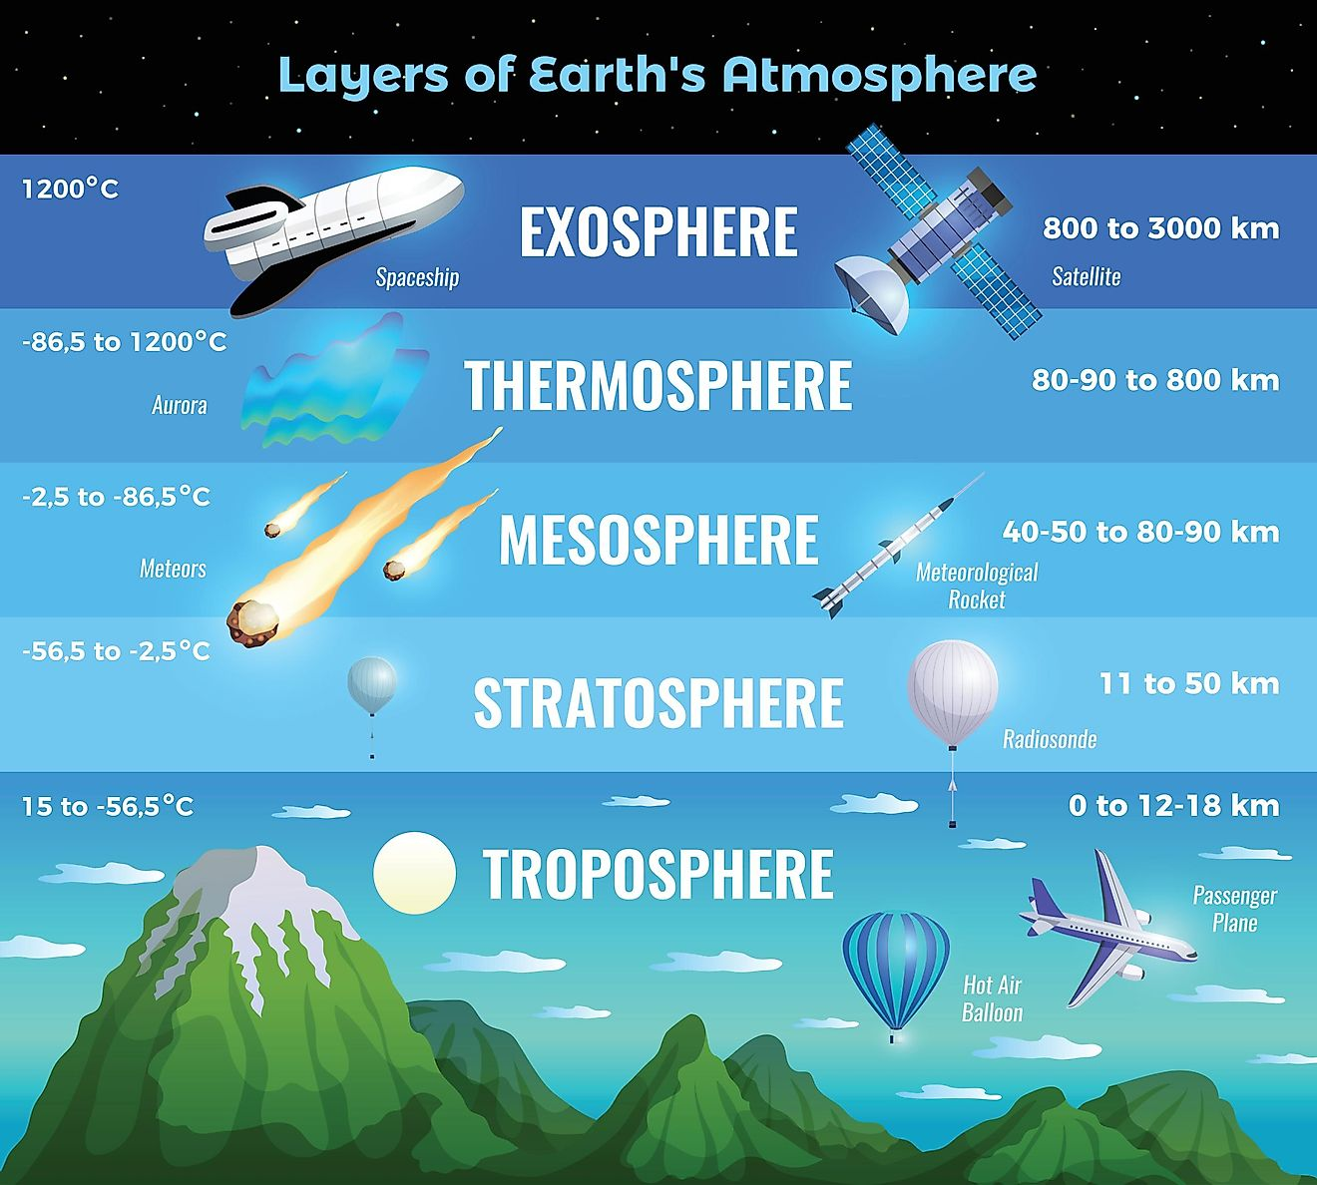
https://www.worldatlas.com/articles/what-are-the-5-layers-of-the-earth-s-atmosphere.html

Slide 4
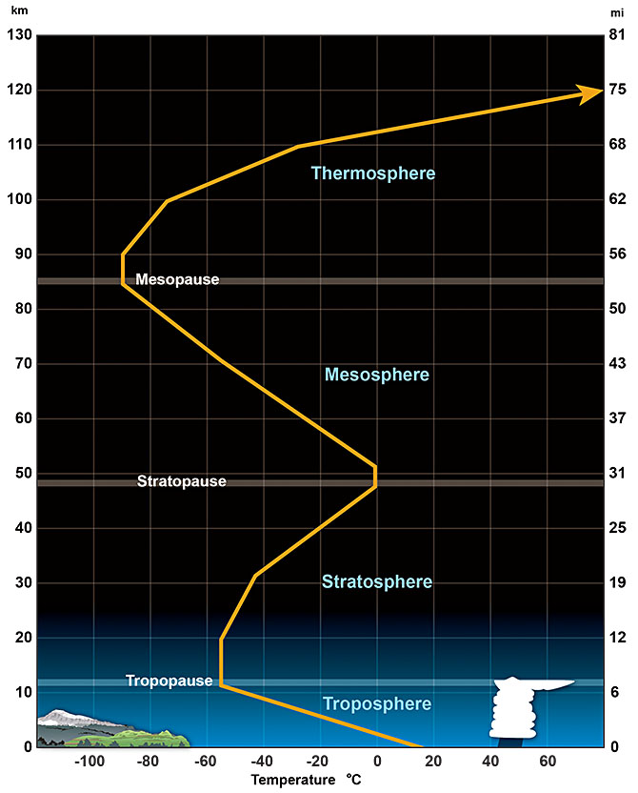
The Mesosphere
Region of atmosphere between 50-85 km
78% Nitrogen, 21% Oxygen, 1% other
Temperature range 180-270 K, at the Mesopause is where temperature rises
Top of mesosphere defined by the mesopause (minimum temp boundry)
Dense enough to cause incoming meteors to ablate
https://www.weather.gov/jetstream/layers

Slide 5
The Mesosphere’s Energy budget
The balance between multiple dynamic processes in the atmosphere that absorb/release energy
Direct effect on temperature of the mesosphere
Heating Mechanisms: 1. Solar Heating 2. Exothermic Chemical Reactions
Cooling Mechanism: 1. Infrared radiative cooling

Slide 6
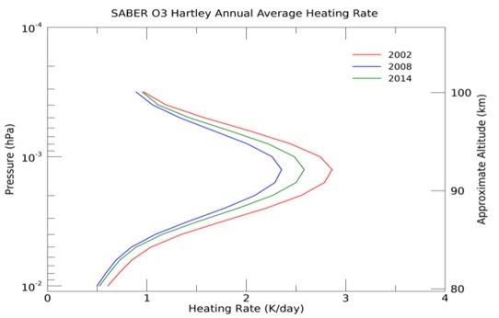
Heating Mechanism: Solar Heating
Absorption of UV rays by O3 and O2
Heating caused by photolysis (breakup) of these molecules at a certain wavelengths
Focus on infrared (762 nm) for O2
Focus on the Hartley band (255 nm) for O3

Slide 7
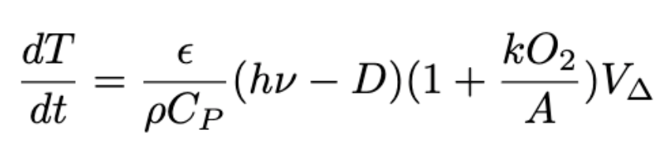
Heating Mechanism: Solar Heating
Solar Heating Rate Equation
Derived from the first law of thermodynamics, heating by photolysis and airglow emission
Some values can easily be retrieved from online, others were provided by Dr. Mylnczak from SABER data

Slide 8
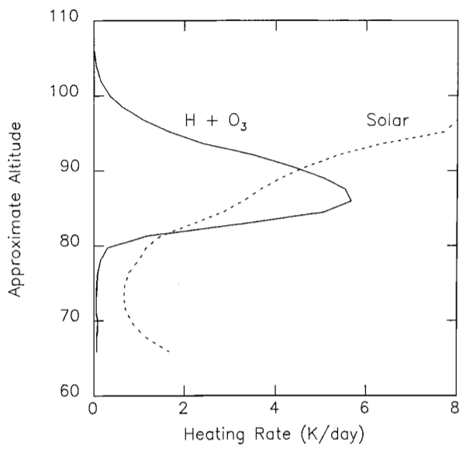
Heating Mechanism: Chemical Reactions
Portion of absorbed UV rays converted to chemical potential energy
7 exothermic reactions release heat into the mesosphere
Most notably H + O3 = OH + O2 (-76.9 kcal/mol)

Slide 9
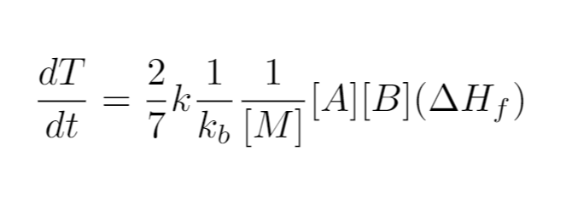
Heating Mechanism: Chemical Reactions
Chemical heating rate equation:
Includes reaction rate coefficient, number density of the atmosphere, and reactant concentrations
Applies to the biomolecular reactions, a similar equation applies to the recombination reactions

Slide 10
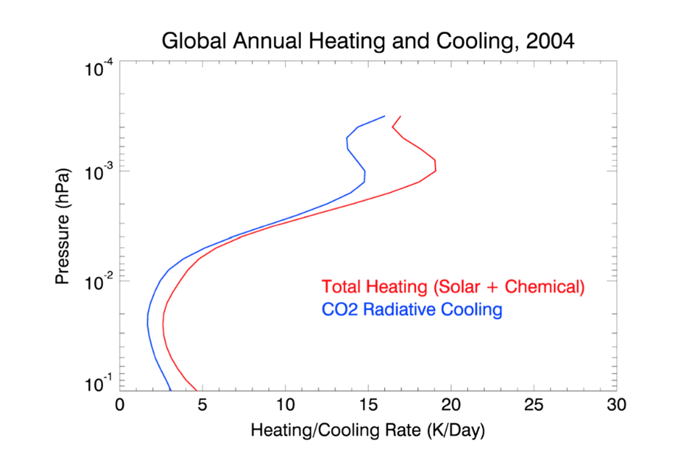
Cooling Mechanism: Infrared CO₂ Cooling
Can't directly calculate the cooling from theoretical models
Measurment's are made with SABER and cooling profiles are constructed and combined to create a yearly cooling rate
For this project, we reconstructed the following plot

Slide 11
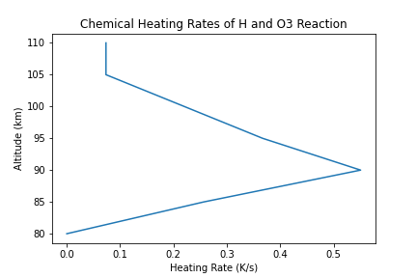
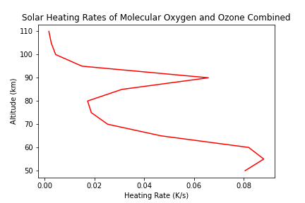
Plots from Calculations
Included here are the solar and chemical heating rates (plots are in Kelvin/s)

Slide 12
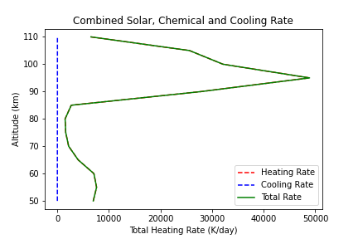
Combined Heating Rate
Here the conversion to Kelvins/day was made for the heating rates
Our values are an about 4 orders of magnitude larger
The cool thus doesn't have an effect for our model

Slide 13
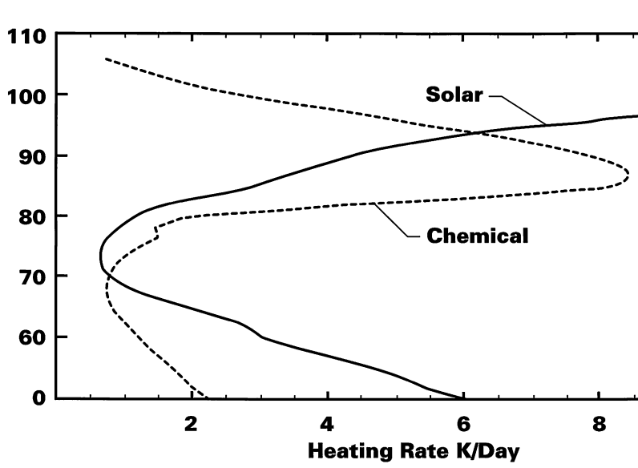
Potential Errors
The shape of our curves matches to a good degree of the accepted curves
This could indicate a conversion error between units or a scale factor missing
Many parameters were not explicitly listed in the literature and the nature of thermodynamic units could units could be the issue

Slide 14
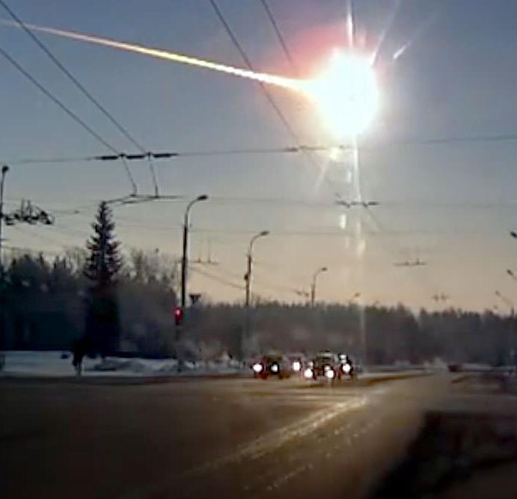
Effect from Meteors?
Vast majority of meteors ablate (burn up) in the mesosphere
Does this heat have a significant effect on the energy budget?
1) Total kinetic energy
2) Total thermal energy
3) Temperature change?
https://www.universetoday.com/109376/happy-1st-anniversary-chelyabinsk-the-fireball-that-woke-up-the-world/​

Slide 15
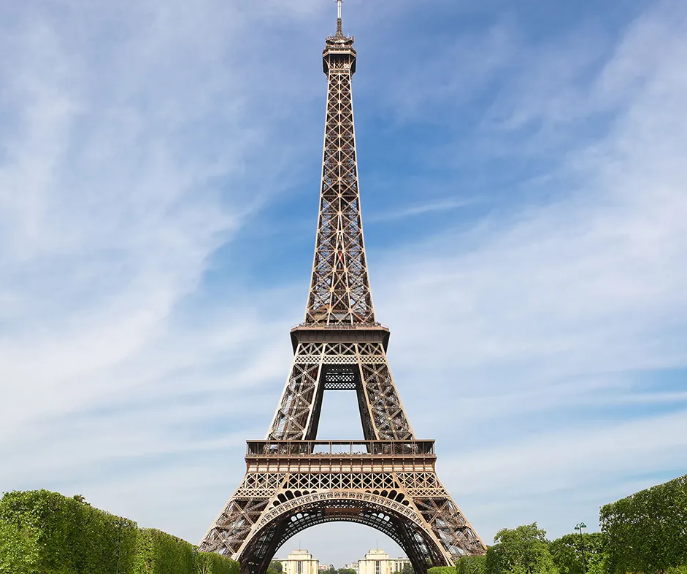
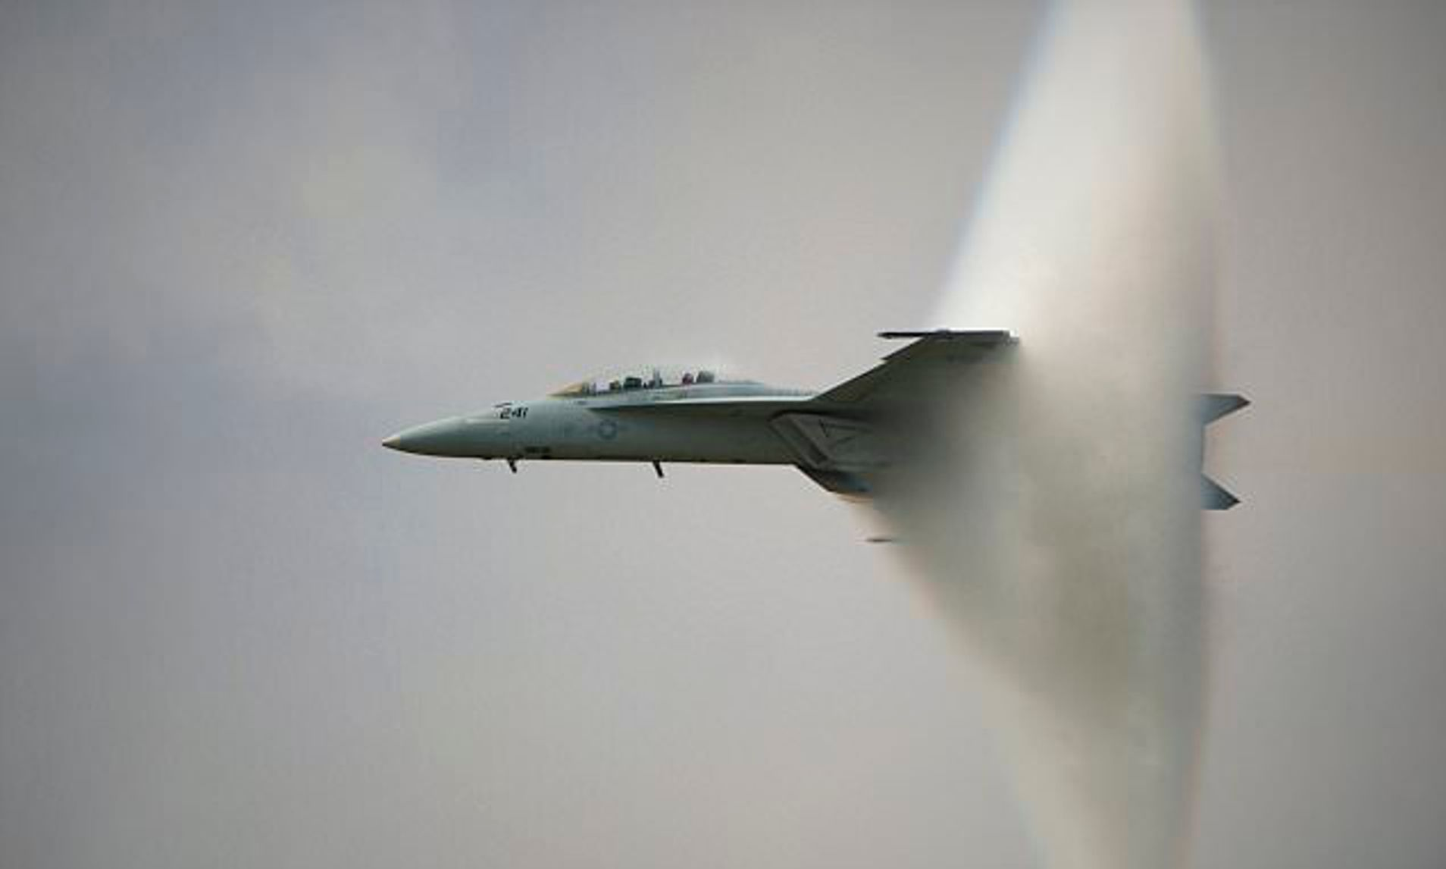
Meteor Kinetic Energy
https://www.dailymail.co.uk/sciencetech/article-2897165/Stunning-photos-capture-awesome-power-fighter-jet-approaches-sonic-boom-creates-vapour-cone-itself.html
Total mass influx of 1.6*10^7 kg yearly (NASA) (1.68 Eiffel Towers)
Average velocity 41 km/s (IAU) (45 times faster than a bullet, 100 times faster than the speed of sound)
https://www.toureiffel.paris/fr/le-monument/chiffres-cle

Slide 16
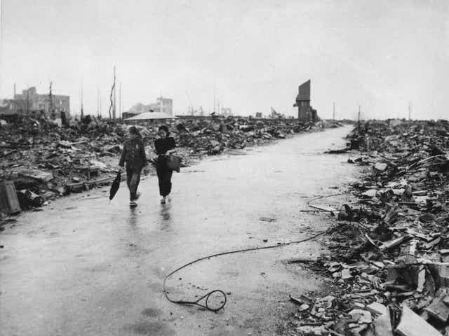
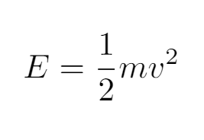
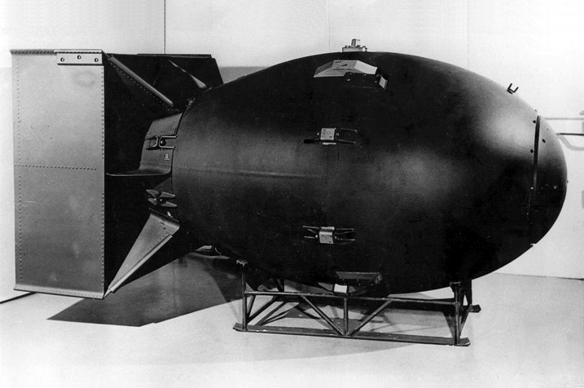
Meteor Kinetic Energy
Total kinetic energy 1.35 x 10¹⁶ joules - 150 "Fat Man" bombs detonated
https://en.wikipedia.org/wiki/Fat_Man

Slide 17
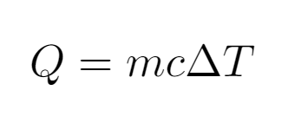
Thermal Energy
~10 percent of KE transformed into visible light, sound, etc.
Assume ~90 percent of KE deposited as heat into atmosphere
Mesosphere mass 5.1 x 10^16 kg (5 billion Eiffel Towers)
Weighted average of N and to determine heat capacity

Slide 18
Meteor Results
Approximate temperature change of 0.64 K per day
Non-negligible when compared to total heating/cooling
Next steps to refine model: 1) Dynamic altitude model 2) Accurate size distribution 3) Include thermal energy absorbed by meteors

Slide 19

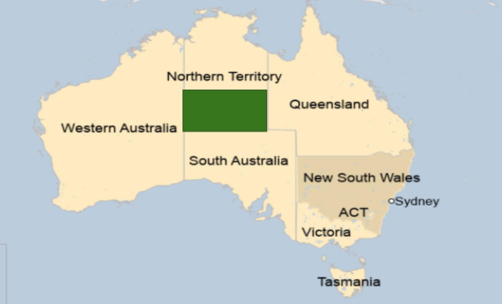
Indigenous Meteoric Connection
Hamacher, Duane & Norris, Ray. (2010). Australian Aboriginal Geomythology: Eyewitness Accounts of Cosmic Impacts?. 22.
Tribes in Northern and Central Australia have deep cultural ties to meteoric phenomena
Beliefs widely vary from evil spirits to bringers of life
Strong ties could possibly be due to open landscape that allowed for easy viewing of meteors and easy discovery of meteorites/craters
Central
Australia

Slide 20
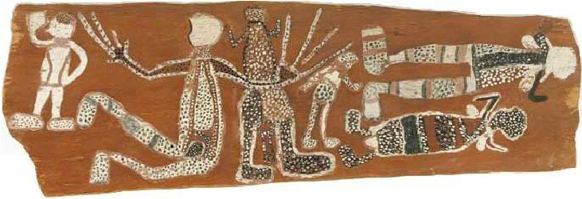
Arrente Tribe
Hamacher, D.W. and Norris, R.P. (2010) Meteors in Australian Aboriginal Dreamings, WGN – Journal of the International Meteor Organization, 38(3), 87-98
Believed meteors contained evil magic known as Arungquilta that was meant to harm others
Ceremonies were preformed to harness this magic for murderous purposes
Usually involved throwing a stick or spear towards an enemy, and waiting for a meteor to appear and "confirm" the kill
Commonly used on someone that broke a taboo as well as enemies

Slide 21
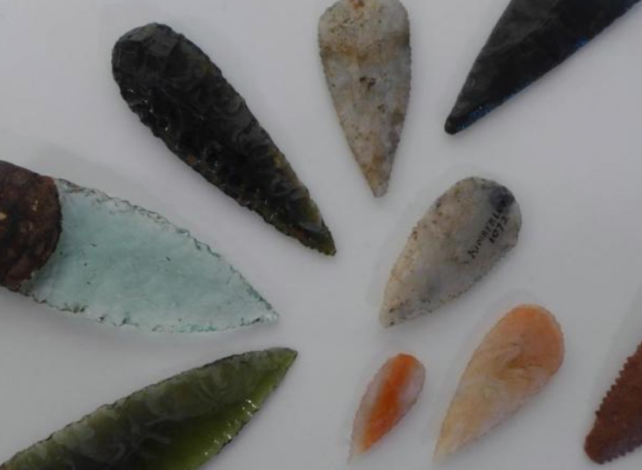
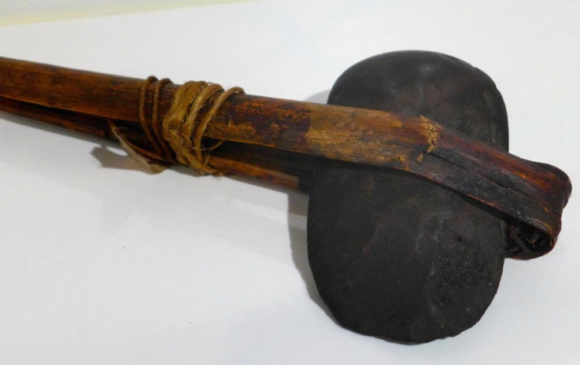
Lurijta Tribe
Believed meteorites were sacred objects, thrown down to Earth by celestial deities
Commonly found meteorites and used them to create ritual tools
Tell stories of "glowing stones" falling onto one of their campsites and killing a man
Believed this man was punished by the Gods for his secrets
https://www.ancient-origins.net/artifacts-other-artifacts-news/written-stone-neolithic-weapons-and-tools-australian-aboriginals

Slide 22

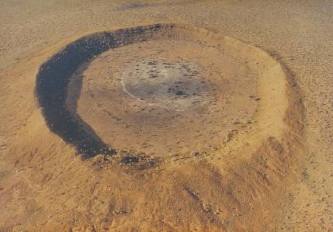
Creation Stories
Commonly held belief is that comet debris brought life to the planet Earth
Life bringing meteor named "Kulu" was thrown by a "great old man" splitting into three pieces on arrival
Consistent with Western sciences best creation theory
Wolfe Creek Crater created 3000 years ago
https://www.abc.net.au/science/articles/2011/03/15/3160848.htm
https://parks.dpaw.wa.gov.au/park/wolfe-creek-crater

Slide 23
Summary
We attempted to recreate heating curves based off theoretical models and data we had available
Although the rates were off by a few orders of magnitudes, the curves of the plots matched known trends
Posible future work could include verifying parameters not explicitly listed in reference literature (we might end up showing Dr. Mylnzcak what we got)
Incoming meteors do seem to have a small heat increase on the total theoretical heating rate (in K/day)
Please refer to the reference section in the report for a full list of references

